Slide 1

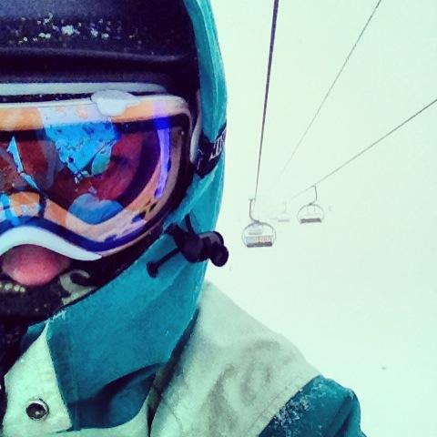
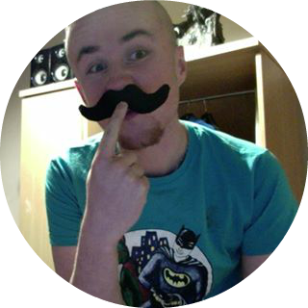
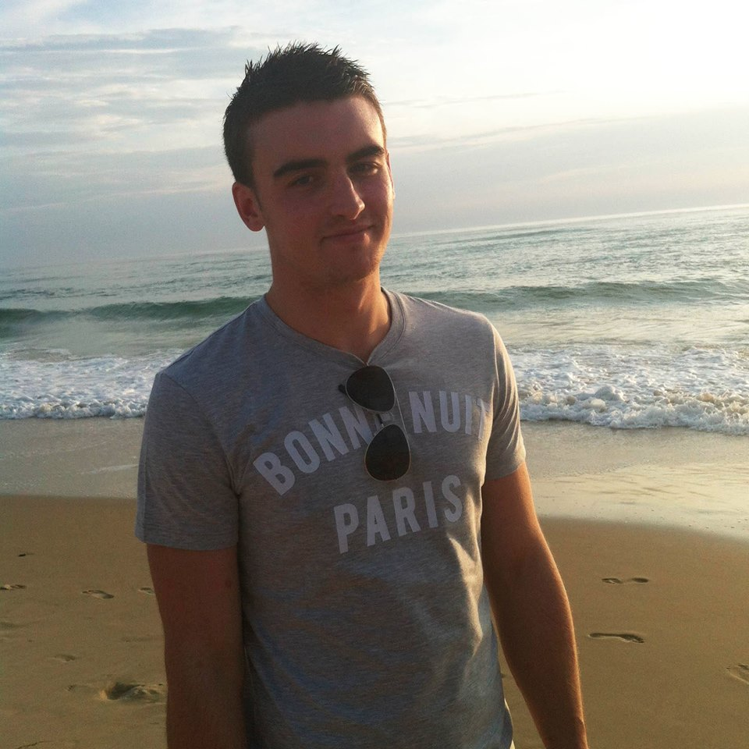
Note Tracking
Brie Lloyd-Evans
Robert Gabriel
Peter Bohane

Slide 2
Overview

Slide 3
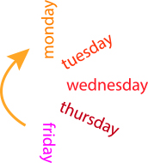
Overview
Our idea is to create an app which
Record your class timetable
Alert you about upcoming classes
Take notes on the class within the same app.
Upload these notes to the cloud
There is no app like this on the market.
R

Slide 4

Aims
A Cross Platform app ( Android and Web)
A Business model and plan for launch.
A Live website for Beta Signup.
R

Slide 5
Background
Constant timetable changes
Running late for class
Not knowing where your next class is!
Losing your class notes
B

Slide 6
Objectives
A cross platform app
Sync information (app to desktop etc)
Clean, modern, easy-to-use interface.
Reminders about class
Input their timetable
Organizing notes through innovative design
B
Notes:
This is short all about 30 seconds

Slide 7
Research

Slide 8
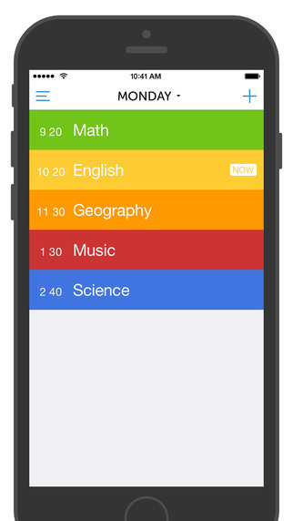
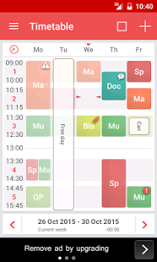
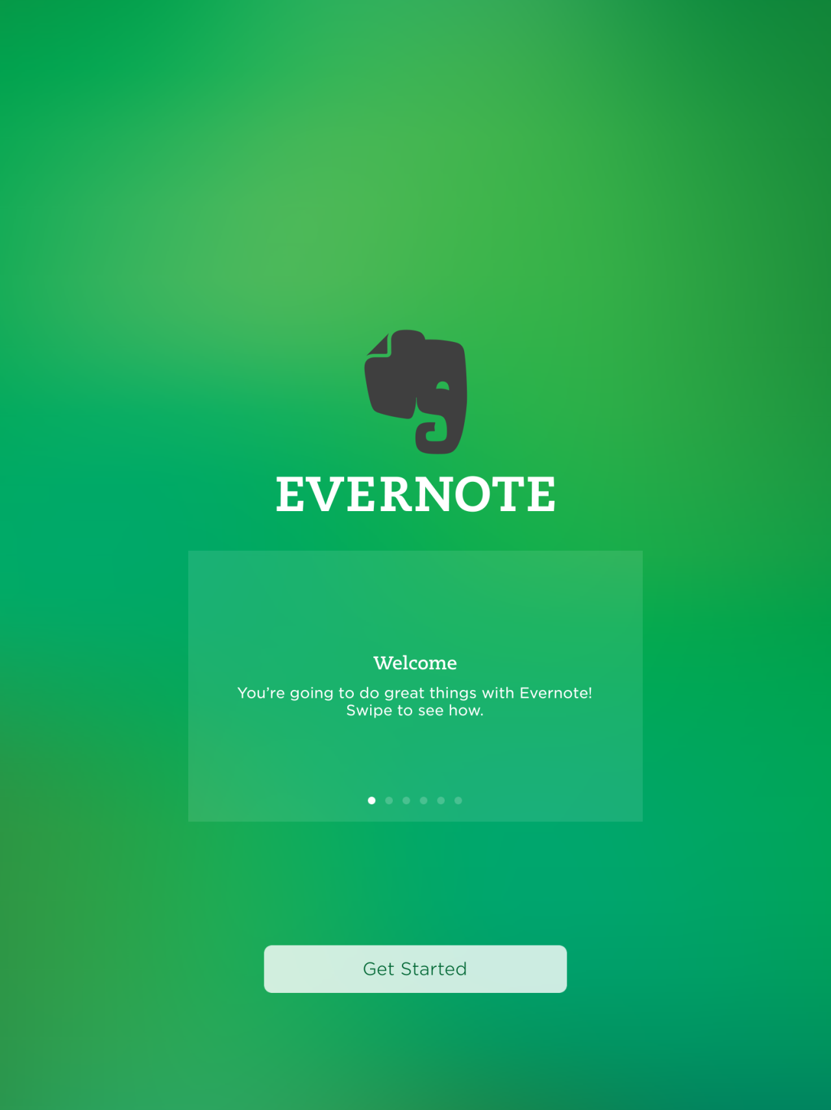
Research : Design
Existing apps lack modern, easy to use interfaces.
Very busy interfaces for the medium
Could improve on intuitive design
No Feedback to the user
B

Slide 9

Research : Needs
No app available on both iPhones and Androids
None offer social login - shareability
Can not take notes and store them in a cloud
Very basic timetables; time & class.
R

Slide 10
Research : Survey
Names
Ages
Devices
Thoughts
Pricing
Survey On Reddit
R

Slide 11

Research : Pricing Models
Premium
Freemium
Subscriptions

Slide 12

Research : User Market
63% of people surveyed use apps for notes taking.
45% rise on tablets and phone use in college year on year
R
100,000,000
https://thejournal.com/articles/2013/05/08/report-students-use-smart-phones-and-tablets-for-school-want-more.aspx
http://www.pearsoned.com/wp-content/uploads/Pearson-HE-Student-Mobile-Device-Survey-PUBLIC-Report-051614.pdf

Slide 13





Research : Technology
One Code base
Multiple Platforms
Android , Web, Ios
R

Slide 14
Conclusion

Slide 15
Conclusion
Current Apps lack great design
There is a need for this app!
Free Version + Subscription models.
Material Design
Web and Model Version
Store the note under that class.
Interdisciplinary, 3PM 4/10/2015
R

Slide 16

Thank you

